Slide 1
NP Completeness

Slide 2
Deterministic algorithms
An algorithm is deterministic if the sequence of steps taken to solve a given problem by an algorithm is pre-determined and linearly ordered
The Turing machine we described is deterministic:
For any state-letter pair, there is only one entry in the transition table
Other than some of the stochastic algorithms, every algorithm in this course has been deterministic

Slide 3
Deterministic polynomial-time algorithms
A deterministic polynomial-time algorithm is such an algorithm that solves any problem in polynomial time
The algorithm is O(n^{k}) for some k ≥ 0
An n ln(n) algorithm runs in polynomial time as n ln(n) = O(n²)
We will represent the totality of all problems that can be solved in polynomial time using a deterministic algorithm by the symbol
P

Slide 4
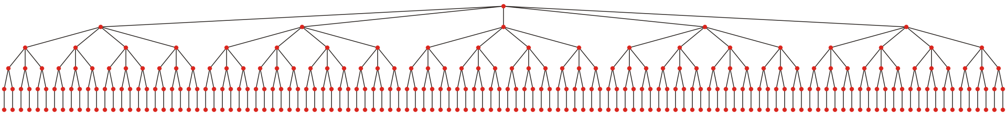
Deterministic polynomial-time algorithms
Consider the travelling salesman problem:
In a complete weighed graph, what is the least weight Hamiltonian cycle?
A deterministic algorithm to find a solution is to do tree traversal
This tries every path
The run time is Θ(|V|!)
The Held-Karp algorithm runs in Θ(|V|² 2^{|V|}) time
It uses dynamic programming
To the best of our knowledge, this problem is not in P

Slide 5
Non-deterministic algorithms
A Turing machine is non-deterministic if the transition table can contain more than one entry per state-letter pair
When more than one transition is possible, a non-deterministic Turing machine branches and creating a new sequence of computation for each possible transition
With C++, consider a process that at some point spawns a thread or another process destined to run on another core or processor

Slide 6
Non-deterministic algorithms
A non-deterministic algorithm can be implemented on a deterministic machine in one of three manners:
Assuming execution along any branch ultimately stops, perform a depth-first traversal by choosing one of the two or more options and if one does not find a solution, continue with the next option
Create a copy of the currently executing process and have each copy work on one of the next possible steps
These can be performed either on separate processors or as multiple processes or threads on a single processor
Randomly choose one of the multiple options

Slide 7
Non-deterministic polynomial-time algorithms
A non-deterministic polynomial-time algorithm is a non-deterministic algorithm that can solve a problem on any input in polynomial time

Slide 8
Non-deterministic polynomial-time algorithms
The travelling salesman problem can solved non-deterministically:
At each step, spawn a thread for each possible path
As you finish, compare them and determine the shortest
The run time is now Θ(|V|)
This is a brute-force search

Slide 9
Non-deterministic polynomial-time algorithms
Let’s try a slightly different problem:
“Is there a Hamiltonian cycle of weight no greater than K?
This is not an optimization problem
It is a Boolean-valued decision problem

Slide 10
Non-deterministic polynomial-time algorithms
Currently, we don’t know any deterministic polynomial-time algorithm that can solve either question:
“What is the Hamiltonian cycle of least weight?
“Is there a Hamiltonian cycle of weight no greater than K?”
In the second case, however, we only have to find one cycle with weight less than K—we may not have to traverse the entire tree

Slide 11
Non-deterministic polynomial-time algorithms
Consider the following decision problem:
“Is there a path between vertices a and b with weight no greater than K?”
Dijkstra’s algorithm can answer this in polynomial time
Dijkstra’s algorithm also solves the optimization problem

Slide 12
Non-deterministic polynomial-time algorithms
On the other hand, the question:
“Is there a Hamiltonian cycle of weight no greater than K?”
seems like it might be easier to solve than
“What is the Hamiltonian cycle of least weight?

Slide 13
Non-deterministic polynomial-time algorithms
Suppose we had an algorithm that could tell us where to look—let’s call such an algorithm an oracle
To answer the question decision question in the affirmative, it is only necessary to find one cycle with weight no greater than K
Suppose this oracle could tell us, in polynomial time, which path to take create the Hamiltonian cycle
We can verify the result in polynomial time by adding up the weights of the edges—an Θ(|V|) operation

Slide 14
Non-deterministic polynomial-time algorithms
Note that finding the minimum-weight Hamiltonian cycle is a much more difficult problem
Even if the oracle found us the path in polynomial time, we cannot confirm that it is the shortest path in polynomial time
We cannot verify the result in polynomial time

Slide 15
Non-deterministic polynomial-time algorithms
Thus, we have two classes of problems
Decision problem | Optimization problem
Is there a cycle of length less than K? | What is the minimum length cycle?
If the answer is “yes”, an oracle could guide us as to the choices we should made at each non-deterministic step and at the end, having added the weights of the edges, we can determine that yes, indeed, the oracle has directed us to a solution that answers the question in the affirmative. | The oracle could guide us as to the choices we should make at each non-deterministic step to find the cycle with minimum length, but we have no means of verifying that this is the shortest cycle without checking all other solutions; that is, we cannot verify the solution in polynomial time.

Slide 16
NP and NP Hard
We will say that both these problems are NP Hard
Solving either one allows us to solve the decision problem
Any problem that we
Can solve on a non-deterministic machine in polynomial time and
Verify on a deterministic machine in polynomial time,
will be said to be in the class NP
This includes the decision problem, but not the optimization problem
The class NP also includes P
Claim: The traveling salesman decision problem is simultaneously
The easiest NP Hard problem
The most difficult NP problem

Slide 17
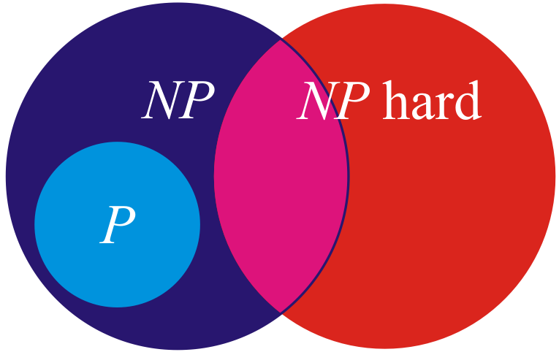
NP and NP Hard
Consider this Venn diagram where P ⊆ NP
What is the minimum length Hamiltonian cycle?
Polynomial-time algorithms?
Polynomial-time algorithms
Exponential-time algorithms
Is there a Hamiltonian cycle of length no greater than K?

Slide 18
P and NP
We know that P ⊆ NP
The million dollar question:
For every problem that is in NP, are there algorithms that can solve those problems in polynomial time on a deterministic machine?
That is, can we solve the traveling salesman decision problem in polynomial time on a deterministic machine?
More succinctly:
Is P = NP ?

Slide 19


P and NP
Why is it a million dollar question?
It is one of seven Millennium Prize Problems posed by the Clay Mathematics Institute
Correct solutions will result in a prize of one million U.S. dollars
New Line Cinema
http://demonocracy.info/

Slide 20
NP problems
We will now look at a number of NP problems that have no known deterministic polynomial-time solutions
We have already seen the travelling salesman problem
Boolean satisfiability problem
The knapsack problem
Subset sum problem
Sub-graph isomorphism problem
Hamiltonian path problem
Graph coloring problem
Clique problem
Independent set problem
Vertex cover problem
Dominating set problem
Integer programming problem

Slide 21
Boolean satisfiability
The Boolean satisfiability problem
Given a Boolean expression, is there at least one combination of values of the Boolean variables such that the expression is true?
Cook showed that, in a sense, this was the most difficult NP problem in his 1971 paper The Complexity of Theorem-Proving Procedures
If a polynomial-time deterministic algorithm can solve this problem, then polynomial-time deterministic algorithms can solve all NP problems, including the traveling salesman decision problem
Refer to *2.82 from Principia Mathematica by Russell and Whitehead

Slide 22

Knapsack problem
The knapsack problem
Suppose a container can hold a maximum weight W
Given a number of items with specified weights and values, is there some combination of items that has a total value greater than or equal to V without exceeding the maximum weight W?
The general optimization problem is NP Hard

Slide 23
Subset sums
The subset sum problem
Given a set of integers, is there a combination of those integers that adds to zero?
{–915, –791, –499, –453, –257, –184, –73, 90, 207, 510, 541, 563, 721, 755}
{–961, –715, –672, –655, –188, –147, –124, 253, 256, 547, 629, 763, 806, 815}
{–991, –891, –638, –550, –549, –454, –453, –144, 17, 217, 259, 370, 538, 566, 651}

Slide 24
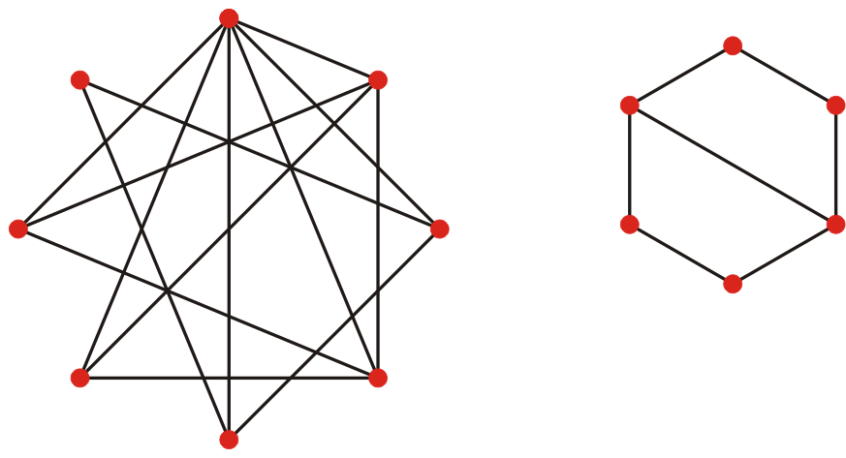
Sub-graph isomorphisms
The sub-graph isomorphism problem
Given two graphs, is one graph isomorphic to a sub-graph of the other?
Here, does the left graph have a subset of six vertices and a subset of edges such that it looks the same as the graph on the right?

Slide 25
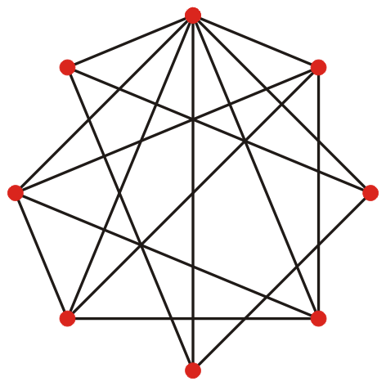
Hamiltonian paths
Hamiltonian path problem
Does a graph have a Hamiltonian path?
Is there a simple cycle of length |V|?

Slide 26
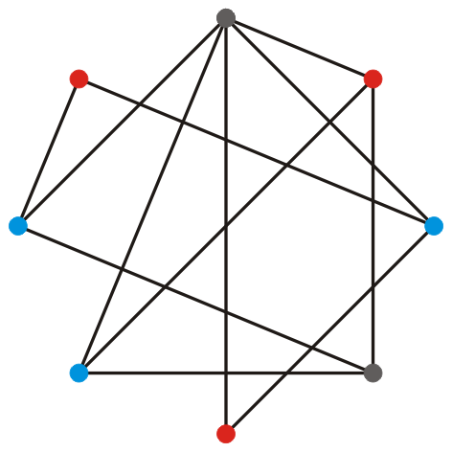
Graph colorings
The graph coloring problem
Given a graph and n colors, is it possible to assign one of the colors to each of the vertices so that no adjacent vertices have the same color?
Complete graphs requires |V| colors
Finding the smallest number of colors for a graph is NP Hard

Slide 27
Cliques
The clique (complete sub-graph) problem
Does a graph have a clique of size at least n?
Given a graph, find the largest clique is NP Hard

Slide 28
Independent sets
The independent set problem
Given a graph, is there a set of n vertices such that no two vertices in that set are adjacent?
Finding the largest set of such vertices is NP Hard

Slide 29
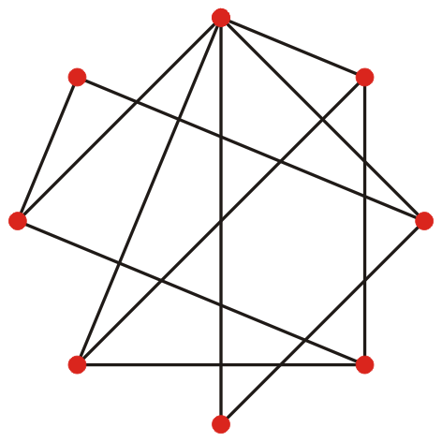
Vertex covers
The vertex cover problem
Given a graph, is there a set of n vertices such that every edge is incident with at least one of those vertices?
Finding the minimum number of such vertices is NP Hard

Slide 30
Dominating sets
The dominating set problem
Given a graph, is there a set of n vertices such every vertex is adjacent to at least one of the vertices in the set?
Finding the smallest set of such vertices is NP Hard

Slide 31
Integer programming
Given an objective function and a set of constraints
Find 0 or 1 values of the variables that satisfy the constraints and maximize the objective function
Objective function: v + 2w + 3x + 4y + 2z
v + 2w + x ≤ 3 v ≥ 0
2v + 3w + 2y ≤ 6 w ≥ 0
3v + 2w + z ≤ 5 x ≥ 0
v + 2x + 2y ≤ 4 y ≥ 0
3v + 2x + 2z ≤ 6 z ≥ 0
2v + y + 4z ≤ 6
w + 2x + y ≤ 3
2w + x + z ≤ 3
2w + 2y + 2z ≤ 5
x + y + z ≤ 2
Allowing the variables to take on integer values is NP Hard
Maximum at v = x = y = 1
w = z = 0
Maximum at y = 2
v = 1
w = x = z = 0

Slide 32
NP problems
Question: Suppose that we find a deterministic polynomial-time algorithm to solve one of these problems—does this help us with finding solutions to the other problems?
To answer this, we must define a reduction of a problem
A reduction is a transformation of one problem A into another problem B such that the solution to B yields a solution to A
A reduction that may be preformed in polynomial time is said to be a polynomial reduction

Slide 33
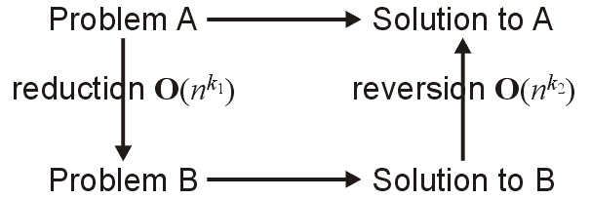
Polynomial reduction
Graphically, we may think of the following image:
To solve Problem A, we:
Reduce the problem to Problem B in polynomial time
Solve Problem B
Revert the solution back into a solution for Problem A

Slide 34
Polynomial reduction
For example, to multiply two n digit decimal numbers:
Reduction: convert the two numbers into binary numbers
Multiply the two binary numbers
Reversion: convert the solution back into a decimal number
Both the reduction and the reversion run in Θ(n) time
If a decision problem is reduced to a decision problem, the corresponding result can be returned in Θ(1) time

Slide 35
Polynomial reduction
Another example: Does a list have a duplicate element?
Reduction: Sort the list
Simpler problem: Does a sorted list have a duplicate element?
Reversion: Return true or false, as is
Both the reduction and the reversion run in Θ(n) time
If a decision problem is reduced to a decision problem, the reversion is therefore Θ(1)
Either the solution or its negation

Slide 36
Polynomial reduction
Can we reduce the Hamiltonian path problem to the travelling salesman problem?
Finding a Hamiltonian cycle to finding a cycle in a complete weighted graph with weight less than or equal to K

Slide 37
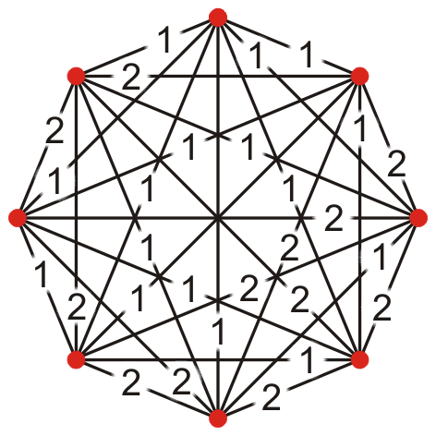
Polynomial reduction
Can we reduce the Hamiltonian path problem to the travelling salesman problem?
Each edge has weight 1 and include all other edges with weight 2
Is there a Hamiltonian path of weight less than or equal to |V|?

Slide 38
Polynomial reduction
Can we reduce the Hamiltonian path problem to the travelling salesman problem?
The reduction runs in O(|V|²) time
The Boolean answer immediately transfers back

Slide 39
NP Completeness
Observations
All these NP problems we just saw are polynomially reducible to each other
Find a deterministic polynomial-time solution to one, you find it to all
Cook first showed this in his 1971 paper on the Boolean satisfiability problem
We refer this class of most difficult class of NP problems as being
NP Complete
All NP problems that are NP Hard are NP Complete

Slide 40

NP Completeness
Travelling salesman decision problem
0-1 programming problem
Hamiltonian path problem
Independent set problem
Dominating set problem
Graph coloring decision problem
Clique problem
Subset sum problem
Vertex cover problem
Sub-graph isomorphism problem
Boolean satisfiability problem
Knapsack decision problem

Slide 41
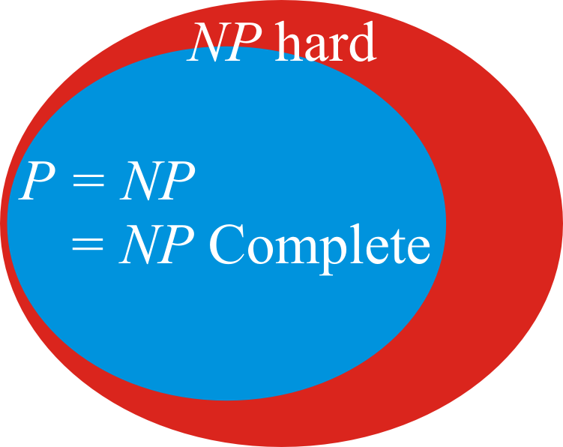
NP Completeness
One last question:
Are there problems that are NP but neither P nor NP Complete?
Ladner’s theorem says:
If P = NP, then “no”
If P ≠ NP, then “yes”

Slide 42
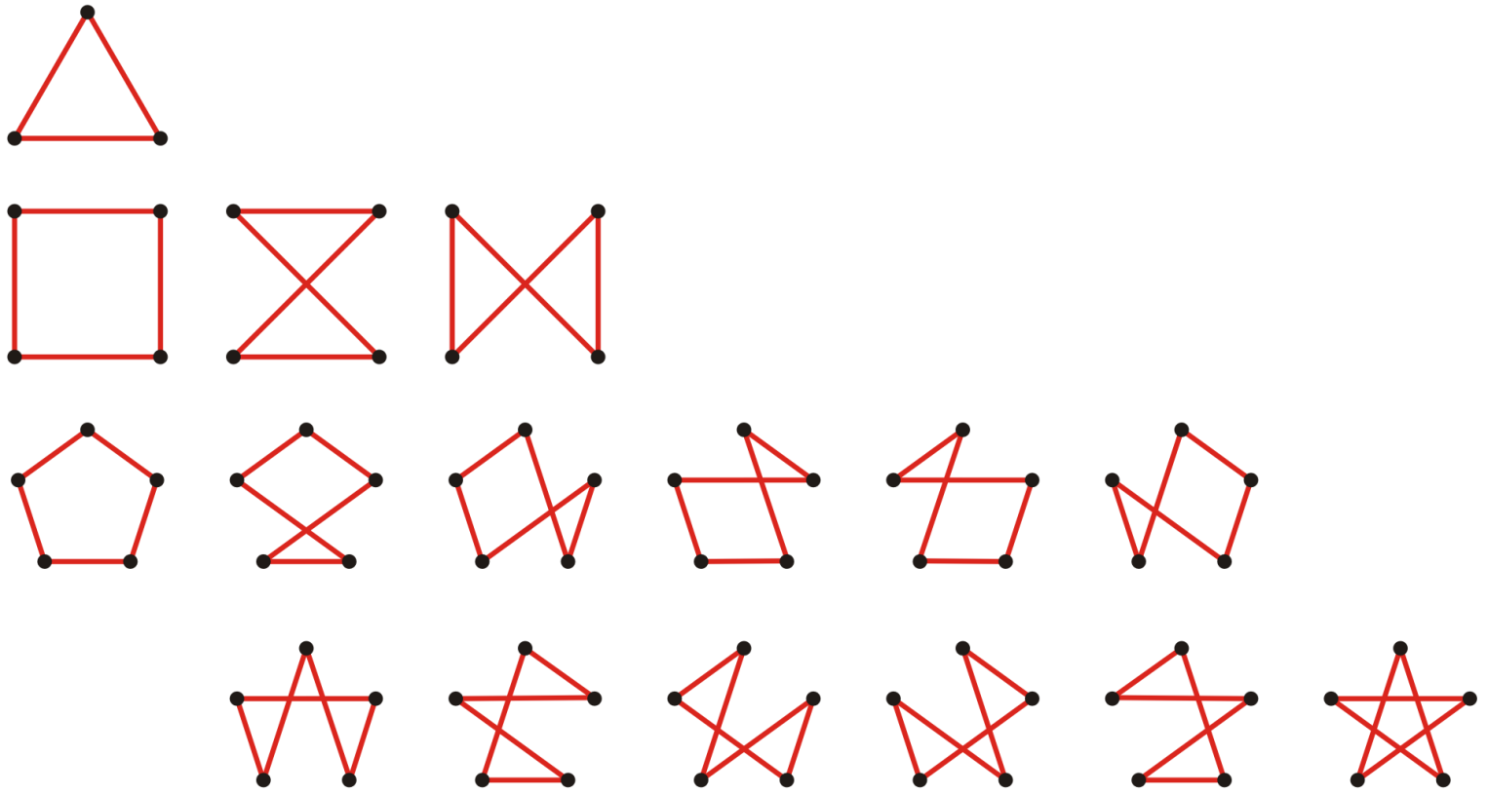
NP Completeness
From the description of the traveling salesman problem, there are
different Hamiltonian paths
Trying all these paths would be Θ(n!)
How much work is it to solve the optimization version?

Slide 43
NP Completeness
How could we define a recursive function to solve this?
Number the vertices 0, …, n – 1
We will start at vertex 0
Let V₀ = {1, 2, …, n – 1}
Suppose we define tsp( S, k ) to be the shortest cycle visiting all the vertices in S once starting at 0 and ending at k
Now
In general,
where S ⊂ {1, 2, …, n – 1}
Define tsp({}, k) = w_{0, k}
Use dynamic programming…

Slide 44
NP Completeness
How many different arguments can be passed to tsp(S, k)?
There are at most 2^{n} possible subsets of V
There are n – |S| possible second arguments
Thus, the number of possible arguments is O(n 2^{n})
The actual number asymptotically approaches 0.25 n 2^{n}
How many calculations are there?
Each calculation is |S| < n, so an estimate to the number of calculations is O(n² 2^{n})
The actual number asymptotically approaches 0.125 n² 2^{n}
Thus, we require Θ(n 2^{n}) memory with Θ(n² 2^{n}) time
As any NP Complete problem is polynomially reducible to the traveling salesman problem, the run time is O(n² 2^{n})

Slide 45
NP Completeness
Question:
Can we simplify this algorithm for the decision problem?
Recall, we are simply asking if there is a path no greater than K
Is there any way to prune the number of possible paths taken?
Recall that backtracking reduced the solving of Sudoku to a few thousand iterations

Slide 46
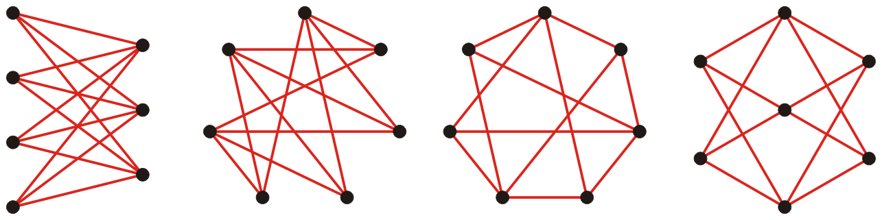
Graph isomorphisms
Recall the sub-graph isomorphism problem
Given two graphs, is one graph isomorphic to a sub-graph of the other?
A possibly easier question is:
Are two graphs isomorphic?
So far, the best algorithm is

Slide 47
Prime factors
On the other hand, the problem
Does n have a prime factor p less than or equal to m?
was shown in 2002 to be in P
Yes, people are still looking into this!

Slide 48
Other complexity classes
The upshot is:
If you need to solve an NP Complete problem for your solution, you will require an exponential amount of time…
Two other complexity classes are:
Problems that can be solved with O(ln(n)) memory: L
What can be computed with limited memory?
Problems that can be solved in O(ln^{c}(n)) time if you have O(n^{k}) processors: NC
What can be computed efficiently in a distributed system?
This includes:
Integer multiplication and division
Matrix multiplication
Finding the determinant, inverse and rank of a matrix

Slide 49
Summary
In this topic, we covered:
Deterministic polynomial-time algorithms P
Nondeterministic polynomial-time algorithms
Those that can be verified in deterministically in polynomial time are NP
NP Hard problems
The class of NP Complete problems
Question: is P = NP?

Slide 50
References
Wikipedia, http://en.wikipedia.org/wiki/NP-complete
Personal conversations with Therese Biedl
Folkmar Bornemann, PRIMES Is in P: A Breakthrough for “Everyman”
http://www.ams.org/notices/200305/fea-bornemann.pdf
These slides are provided for the ECE 250 Algorithms and Data Structures course. The material in it reflects Douglas W. Harder’s best judgment in light of the information available to him at the time of preparation. Any reliance on these course slides by any party for any other purpose are the responsibility of such parties. Douglas W. Harder accepts no responsibility for damages, if any, suffered by any party as a result of decisions made or actions based on these course slides for any other purpose than that for which it was intended.

